Slide 1
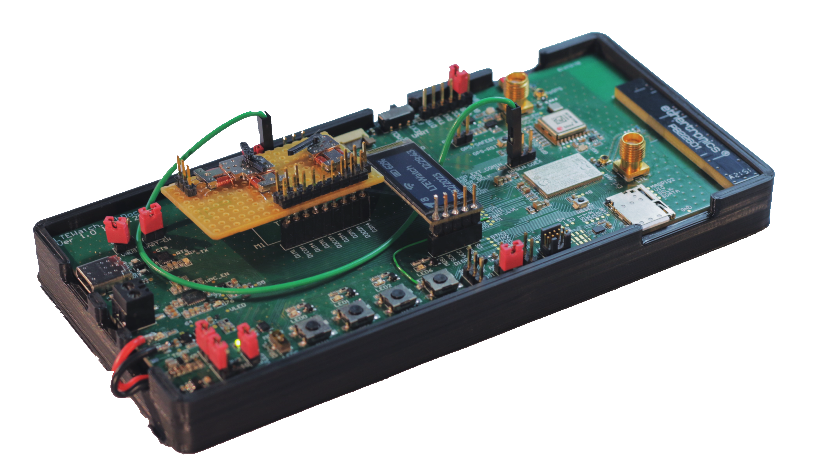
TM Project Defense
Analog LTE-M / NB-IoT Watch
Tristan Traiber – 22.02.2022 – MSE – EIE - TIN

Slide 2
TM Project Defense - Analog LTE-M / NB-IoT Watch
Table of contents
Introduction
Project Description
Scope & Limitation
Literature Review & Research
Wearable & Low-Power App
System MCU (nRF9160 SiP)
System Power Supply
Cellular IoT & GNSS
Results & Solutions
Specification
Functional Decomposition
Component Selection
Hardware Part
Electrical Schematic
LTEWatch Prototype Board
Antenna Part
Cellular (LTE-M/NB-IoT)
GNSS
Software Part
LTEWatch Application Decomposition
LTEWatch Application Diagram
Software Architecture
External Library
Hardware Description
Test & Result
LTEWatch Device
GNSS & LTE-M/NB-IoT
Discussion
Personal Evaluation
Remaining Work
Conclusion

Slide 3
Introduction
Project Description
About Nordic Semiconductor
Fabless Semiconductor Company from Norway
Specialized in wireless communication technologies and IoT
Pioneer role in development of Bluetooth Low Energy (BLE)
Currently developing for ANT+, Thread, Zigbee, LTE-M/NB-IoT, Wi-Fi and GSMA
Goals & Objectives
Develop an analog wristwatch with cellular LTE-M/NB-IoT communication and GNSS position tracking using Nordic’s nRF91 family of devices.

Slide 4
Introduction
Scope & Limitation – Task List
Specification
Elaborate the specification of the device (number of clock hands, battery lifetime, user interface, size, recharging mechanism, case)
Antenna
Study and implement antenna solutions for both GNSS and LTE-M/NB-IoT
Hardware
Component selection
Design of the schematic and PCB of a prototype
Assembly and electrical testing of the prototype
Software
Develop a simple watch application that must implement motorized clock’s hands, buttons, LCD, LTE-M/NB-IoT communication using the MQTT protocol, GNSS position and time tracking, battery charging and level monitoring, accelerometer.
Prototype validation
Test and validation of the entire development
Documentation
Establish a technical report enabling further developments

Slide 5
Introduction
Scope & Limitation – Project Constraint
Limited Time
Limited Resourses
Study and implement antenna solutions for both GNSS and LTE-M/NB-IoT
Hardware
Component selection
Design of the schematic and PCB of a prototype
Assembly and electrical testing of the prototype

Slide 6
Literature Review & Research
Wearable & Low-Power App
…
….

Slide 7
Literature Review & Research
System MCU (nRF9160 SiP)
…
….

Slide 8
Literature Review & Research
System Power Supply
…
….

Slide 9
Literature Review & Research
Cellular IoT & GNSS
…
….

Slide 10
Results & Solutions
System Specification
…
….

Slide 11
Results & Solutions
Functional Decomposition
…
….

Slide 12
Results & Solutions
Component Selection
…
….

Slide 13
Antenna Part
Cellular (LTE-M/NB-IoT)
…
….

Slide 14
Antenna Part
Global Navigation Satellite Systems (GNSS)
…
….

Slide 15
Hardware Part
Electrical Schematic
…
….

Slide 16
Hardware Part
LTEWatch Prototype Board (PCB)
…
….

Slide 17
Software Part
LTEWatch Application Decomposition
…
….

Slide 18
Software Part
LTEWatch Application Diagram
…
….

Slide 19
Software Part
Software Architecture
…
….

Slide 20
Software Part
External Library
…
….

Slide 21
Software Part
Hardware Description
…
….

Slide 22
Test & Result
LTEWatch Device
…
….

Slide 23
Test & Result
GNSS & LTE-M/NB-IoT
…
….

Slide 24
Discussion
Personal Evaluation
…
….

Slide 25
Discussion
Remaining Work
…
….

Slide 26
Conclusion
…
….

Slide 27

Questions

